Slide 1

Body Image in
the Social Media Age
Grades 10–12
Together For Health

Slide 2
1 in 5
young women in Canada will develop an eating disorder in their lifetime — affecting all genders
Eating disorders have the highest mortality rate of any mental health condition.
Together For Health

Slide 3
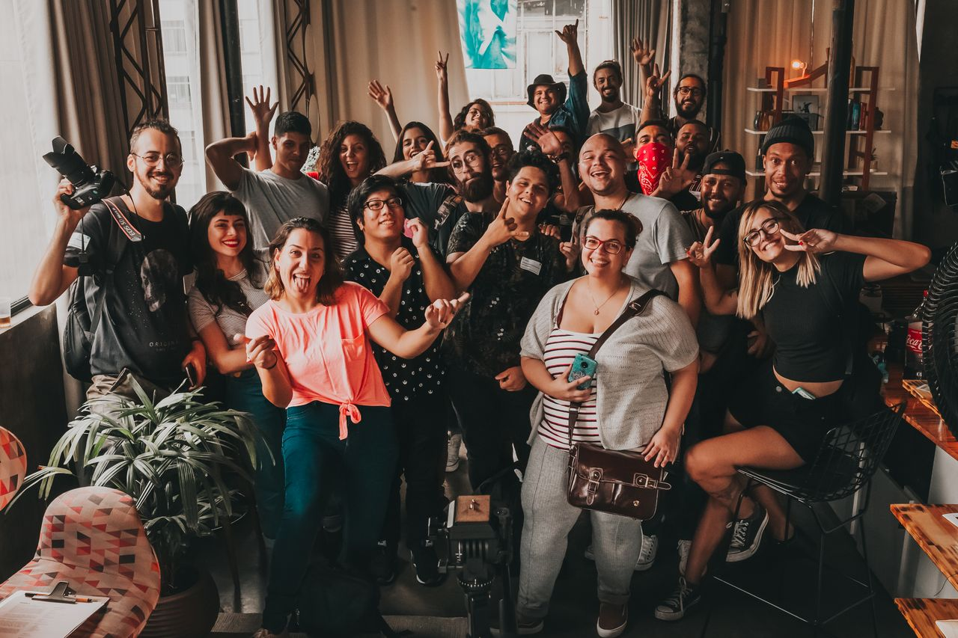
🧠
The Psychology of Body Image
Body image is a multidimensional construct: perceptual, attitudinal, behavioral
Social comparison theory: we evaluate ourselves against social referents
Objectification theory: internalization of the observer's perspective on one's own body
Body dysmorphic disorder: obsessive preoccupation with perceived flaws — distinct from eating disorders
The "thin ideal" is a cultural construct that varies dramatically across cultures and time
Together For Health

Slide 4
🔬
Eating Disorders: What They Are
Anorexia Nervosa: severe restriction, fear of weight gain, distorted body perception
Bulimia Nervosa: recurrent binge-purge cycles
Binge Eating Disorder: most common — episodes of uncontrolled eating without purging
ARFID: avoidant/restrictive food intake disorder — sensory or fear-based
Orthorexia: obsessive focus on "healthy" or "clean" eating — not yet in DSM-5
Together For Health

Slide 5
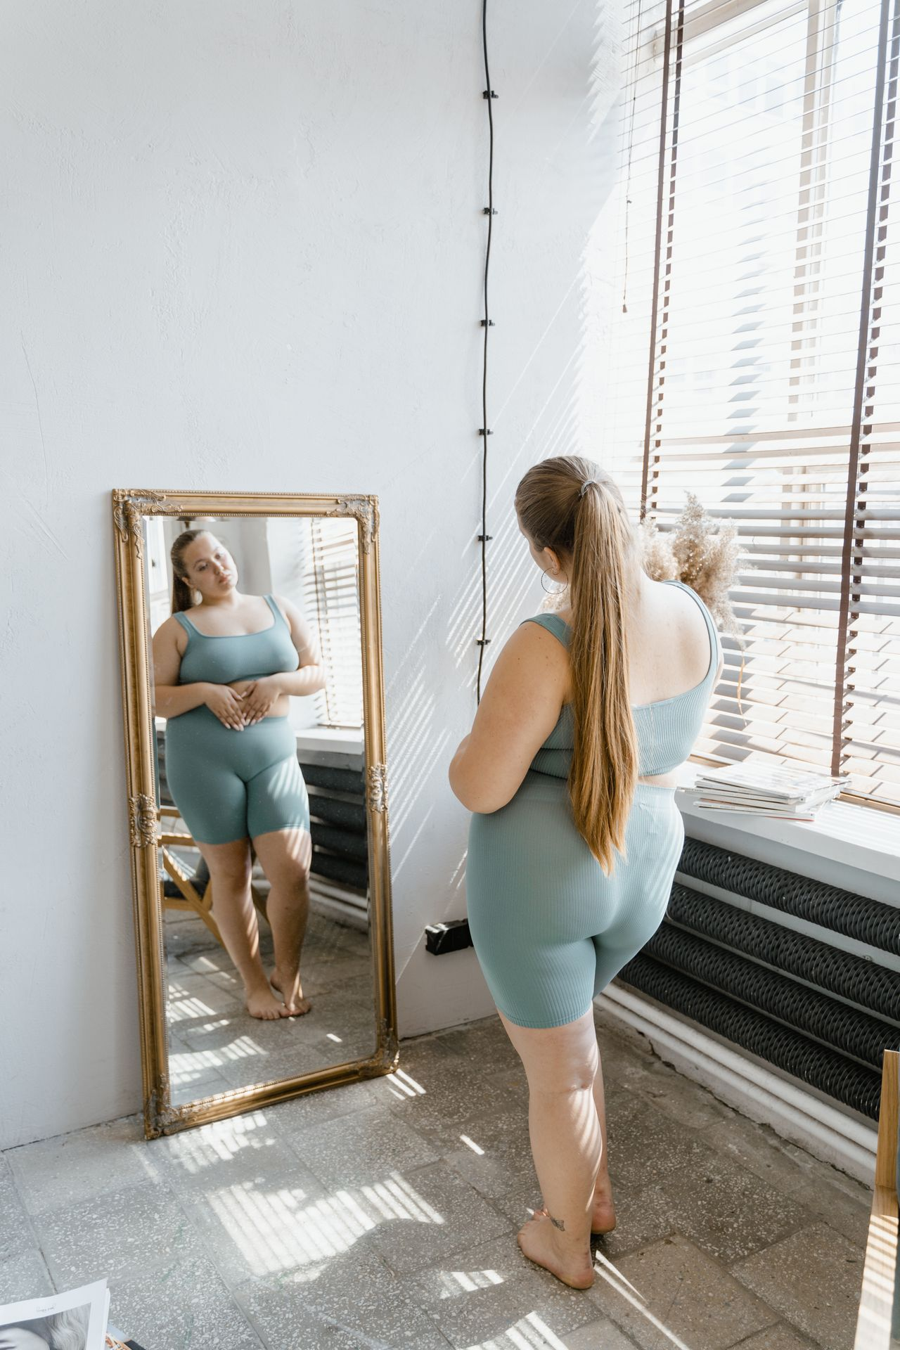
💬
How to Help a Friend You Are Worried About
Express care, not concern about their body: "I care about you and I am worried"
1
Do not comment on food, weight, or appearance
2
Avoid reinforcing diet culture behaviors
3
Offer to go with them to a counsellor or doctor
4
Educate yourself: NEDIC, NEDA, and Body Brave have excellent guides
5
Together For Health

Slide 6
⚖️
Health at Every Size
HAES research consistently shows that health behaviors predict outcomes better than weight or BMI.
Weight stigma in healthcare contributes to worse outcomes. Evidence supports a weight-neutral approach to health.
Together For Health

Slide 7
KEY TAKEAWAYS
Body image is a public health issue requiring media literacy and systemic change
✓
Recovery from eating disorders is possible — early intervention dramatically improves outcomes
✓
Advocating for diverse representation and anti-diet-culture is health activism
✓
Resources
NEDIC: nedic.ca
Body Brave: bodybrave.ca
Glenn Mackintosh: psychologist, evidence-based resources on body image
Together For Health

